Slide 1

HELLO!
Here 1Crore Projects
I am here because I love to give presentations.
You can find me at @1CROREPROJECTS

Slide 2
AN EFFICIENT SEARCH METHOD USING FEATURES TO MATCH JOINT KEYWORDS ON ENCRYPTED CLOUD DATA

Slide 3

AIM OF PROJECT
This project aim is joint keywords to identification we are improvement of security for the private data

Slide 4
ABSTRACT
The continuous improvement of the security of cloud storage, more users upload private data to the cloud. Therefore, this project proposes an efficient search method using features to match joint keywords (FMJK) on encrypted cloud data.
This method proposes that each d keywords are randomly selected from the non-duplicated keywords, which are extracted from the documents of the data owner, to generate a joint keyword, and all joint keywords form a keyword dictionary. Each joint keyword is matched with the feature of the document and the query keyword respectively, the result obtained by the latter is regarded as a dimension of the query trapdoor.

Slide 5
INTRODUCTION
With the rapid development of science and technology, enterprises or individual users increasingly rely on storing a large number of data documents on cloud servers in order to share data quickly and remotely In most of the existing cipher-text sorting retrieval methods, KNN (K Nearest Neighbor) technology is used to create indexes supporting cipher-text retrieval In the process of massive data encryption search, most of the search encryption schemes have high time complexity and large storage. In this project, we propose an efficient search method using features to match joint keywords (FMJK) on encrypted cloud data based on the MRSE (Privacy-Preserving Multi-Keyword Ranked Search over Encrypted Cloud Data) scheme .

Slide 6
EXISTING SYSTEM
There are lot of drawback hear in cloud system.
Missing file and files data in cloud server.

Slide 7
DISADVANTAGES:
Security model not satisfactory for mathematician searches, unclear experimental evaluation.
List of keyword should be determined fastidiously so as to stay length of message down.
Although keywords square measure protected by trapdoors server will do some applied mathematics analysis over search result. Server will generate trapdoor for set of any multi keyword trapdoor request.

Slide 8
PROPOSED SYSTEM
This method proposes that each keywords are randomly selected from the non-duplicated keywords, which are extracted from the documents of the data owner, to generate a joint keyword, and all joint keywords form a keyword dictionary. The data owner upload the document in cloud server.
Then combines each d randomly selected keywords into a joint keyword, and all joint keywords form a keyword dictionary. Thirdly, creates a document index for each document using its exacted keywords and the keyword dictionary and encrypts the document and its encrypted index by means of the key encryption.

Slide 9
ADVANTAGES:
Backup your data in very secure.
The cloud server knows the encrypted data sets and the searchable indexes.
The cloud server not only knows the encrypted data sets and searchable indexes, but also some background information, including the correlation between trapdoors, some statistical information from the encrypted data sets and searchable indexes.

Slide 10
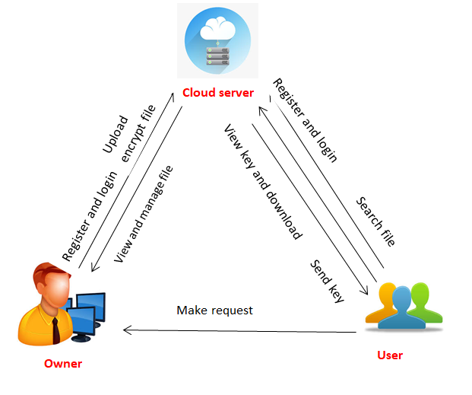
SYSTEM ARCHITECTURE

Slide 11
MODULES
In this project having three modules:
Data owner
Data User
Cloud Server

Slide 12
MODULES DESCRIPTIONS:
Register with basic information.
Login with correct username & password.
Upload the encrypted file
Dataowner can view and manage file
Dataowner can view requested file
logout
DATAOWNER:

Slide 13
MODULES DESCRIPTIONS:
DATAUSER:
Register with basic information.
Login with correct username & password
User can search file based on keyword and sorting result
Make request to data owner
View key and download the file
Logout

Slide 14
CLOUDSERVER:
Login the account with the correct username and Password
Authorize the owner and user
View all owner and user
View all Uploaded file
Logout.

Slide 15
ALGORITHM
Encryption
Encryption is a way of scrambling data so that only authorized parties can understand the information. In technical terms, it is the process of converting human-readable plaintext to incomprehensible text, also known as cipher text.
BM25 algorithm
In information retrieval, Okapi BM25 (BM is an abbreviation of best matching) is a ranking function used by search engines to estimate the relevance of documents to a given search query

Slide 16
SOFTWARE REQUIREMENTS
Operating System : Windows 7/10
Programming Language : JAVA
Database : SQLYog Community
Front End : Net Beans Software.

Slide 17
HARDWARE REQUIREMENTS
System : Intel i3.
Hard Disk : 40 GB.
Monitor : 15 VGA Colour.
Mouse : Logitech.
Ram : 4 GB.

Slide 18
CONCLUSION
In this project, we propose an efficient search method using features to match joint keywords (FMJK) on encrypted cloud data. In the process of creating each dimension of the indexes and the trapdoors, the document features and query keywords are accurately matched with the joint keywords in the keywords dictionary to get a weighted score, which ensures the accuracy of the query. And the reduction of dimension also reduces the overhead of storage space occupied by the indexes and the trapdoors.
The theoretical analysis and experimental results show that the proposed method is more feasible and more effective than the compared schemes.

Slide 19
REFERENCE
[1] Z. Wan and R. H. Deng, ‘‘VPSearch: Achieving verifiability for privacypreserving multi-keyword search over encrypted cloud data,’’ IEEE Trans. Depend. Secure Comput., vol. 15, no. 6, pp. 1083–1095, Nov./Dec. 2016.
[2] Y. Yang, H. Lin, X. Liu, W. Guo, X. Zheng, and Z. Liu, ‘‘Blockchainbased verifiable multi-keyword ranked search on encrypted cloud with fair payment,’’ IEEE Access, vol. 7, pp. 140818–140832, 2019.
[3] N. Cao, C. Wang, M. Li, K. Ren, and W. Lou, ‘‘Privacy-preserving multikeyword ranked search over encrypted cloud data,’’ in Proc. IEEE INFOCOM, Apr. 2011, pp. 829–837.

Slide 20
THANKS!
Any questions?
You can find me at
Reach us – 1croreprojects@gmail.com
Contact / Whatsapp: 7708 150 152 / 9751 800 789 / 790 432 0834

